Slide 1
Session 3: Original Cataloging
  How are fixed fields coded for serials?
  What is the chief source for a serial?
  How do I determine the main entry for serials?
  What title information should be included in
  the record?
Notes:
References
CONSER Cataloging Manual, Modules 3-7
CONSER Editing Guide, Section E, Fields 100-247
CONSER Standard Record Documentation and relevant Library of Congress Rule Interpretations, found at:
http://www.loc.gov/catdir/cpso/conser.html
The objectives of this session are to help the participants create an original catalog record for a serial title and in the process explain the key points in cataloging serials.

Slide 2
Background information:
CONSER Standard Record
CONSER Standard Record Documentation and LC Rule Interpretations:
  http://www.loc.gov/catdir/cpso/conser.html
Background:
  http://www.loc.gov/acq/conser/access-level.html
Notes:
This session will cover description of serials following both AACR2 rules and CONSER standard record guidelines.
Students who want to go deeper into the history and development of the CONSER standard record can take a look at the second Web site listed here.

Slide 3
Philosophy behind the CONSER Standard Record
Meet user tasks for access
Reduce redundancies in cataloging
Help with decision-making process
Work for better utilization of MARC 21 for storage, retrieval and display
Notes:
[Discuss CONSER standard record (CSR) and that it differs from traditional cataloging in some respects. Refer to Cheat Sheet and also Guidelines, and note that all the simplifications/changes in the CSR are covered by Library of Congress Rule Interpretations.]
[Trainer’s Note: Feel free to use as much or as little of this background information as desired.]
A working group to develop the CONSER standard record was formed in late summer 2005 and began its work in the fall of 2005. The Working Group evaluated AACR2 records in terms of user tasks appropriate to serials: find, identify, select and obtain. The Group identified a set of essential data elements that became the basis of the CONSER standard record.
The Working Group also solicited information and opinions from catalogers in the field about areas of serials cataloging that caused either the most time or the most confusion, without resulting in great benefit to the user. This information was used to develop some simplifications to traditional AACR2 practices that could streamline cataloging while eliminating some practices that had created confusion for library users.
In addition, the Working Group recommended changes to future cataloging rules, rule interpretations and CONSER practice. It also recommended changes or additions to MARC 21 as well as better use of existing MARC fields in OPAC retrieval and displays. The CONSER standard record was implemented June 1, 2007.

Slide 4
“CSR” and “AACR2”: Two Practice Labels
CONSER standard record cataloging is an application of AACR2 cataloging
Examples labeled “CSR” show CONSER standard record application of AACR2
Examples labeled “AACR2” show elements beyond the requirements of “CSR”
Notes:
Trainer’s Note: Please make sure that everybody understands that CSR is an application of AACR2. It is the minimum set of requirements for a CONSER-authenticated record, but catalogers can go beyond basic CSR requirements when needed. In this workshop, for shorthand purposes, we have labeled the examples either as “AACR2" or “CSR" to distinguish the full range of AACR2 elements that could be added to a record and the elements that meet basic CSR requirements.
The CONSER standard record is fully supported by LCRIs, just as with other LC and PCC policies and practices.

Slide 5
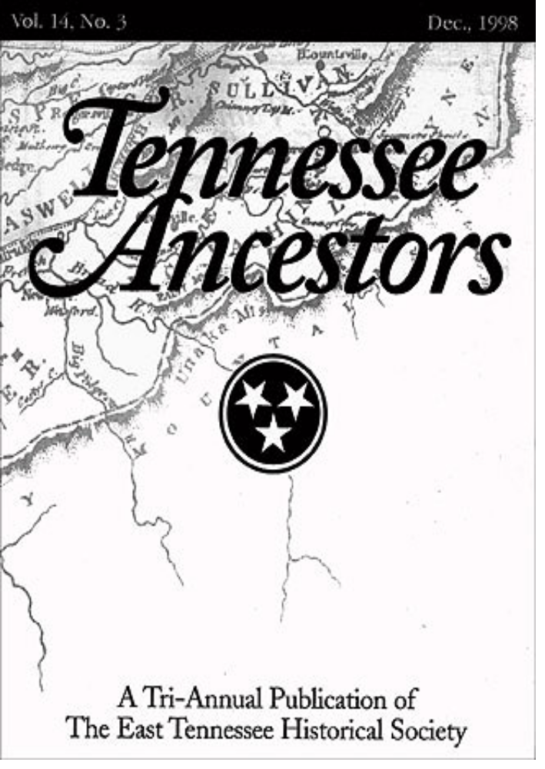
Serial example:
Vol. 14, No. 3 Dec., 1998
Cover
Notes:
[Note: This slide contains animation. Designation flies in.]
The next three slides show three pages found in an issue of Tennessee Ancestors which give different presentations of the title information.
We will examine these pages to determine which is the chief source of information.

Slide 6
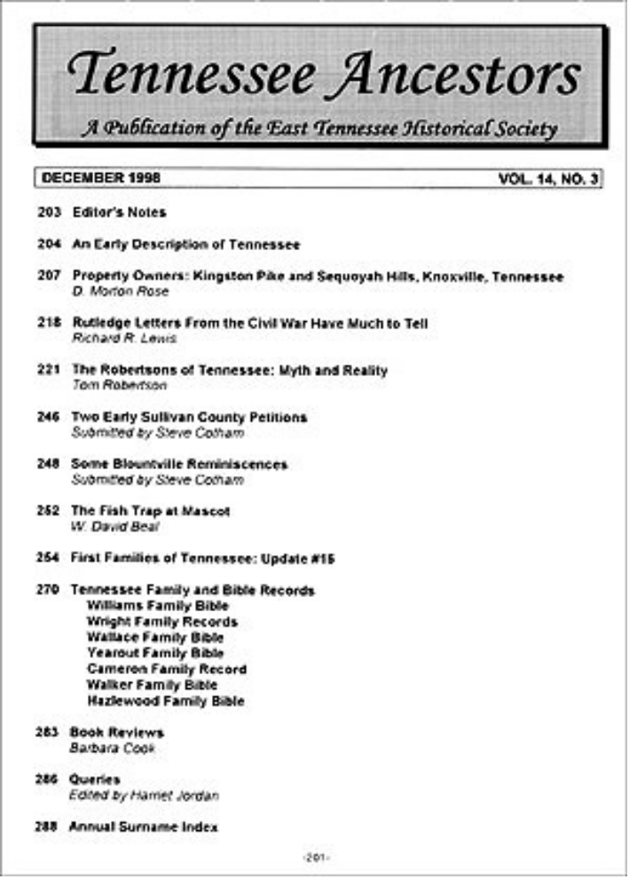
Serial example:
DECEMBER 1998 VOL. 14, NO. 3
Table of Contents
Page 201 (first page)
Notes:
[Note: This slide also contains animation.]
First page (p. 201) is a table of contents for December 1998, Vol. 14, No. 3.

Slide 7
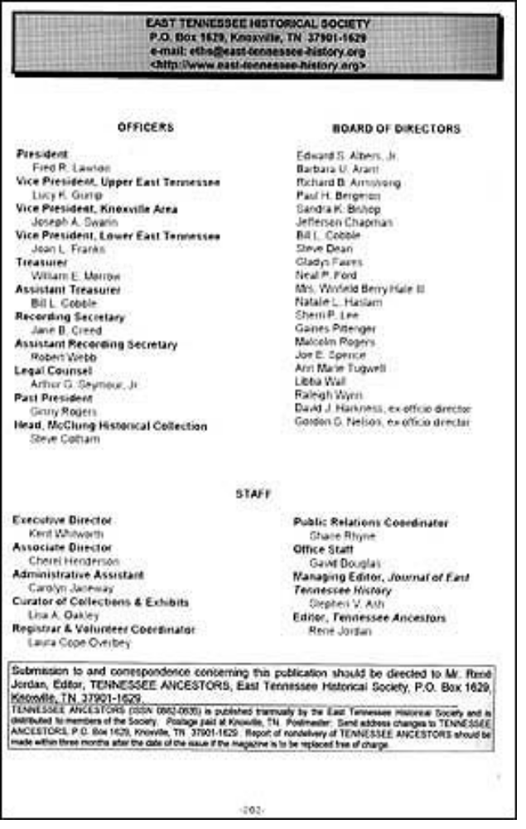
Serial example:
East Tennessee Historical Society
P.O.Box 1629, Knoxville, TN
Tennessee Ancestors (ISSN 0882-0635)
is published triannually by the East
Tennessee Historical Society ...
Verso of Table of Contents
Page ( P. 202)
Notes:
[Note: This slide also contains animation.]
Verso of page 201 is an editorial page. This page contains a masthead title (at bottom).
At bottom: Tennessee Ancestors (ISSN 0882-0635) is published triannually by the East Tennessee Historical Society and is distributed to members of the Society.

Slide 8
Key Elements in the Fixed Field
Publication status = currently published, ceased
(“dead”), or unknown
Beginning/ending dates = base this on year(s) in 362;
when there are multiple years,
use later year (e.g., 1994 for
1993/1994)
Frequency = how often the serial is published
Regularity = is the frequency regular or not
(Coding for frequency and regularity optional in CSR)
Notes:
Our example, Tennessee Ancestors, is a print periodical, so if we were cataloging this title, the Bibliographic Level would be coded as “s” (serial) in the fixed field for the continuing resources format. The language is English (eng); and the country of publication (coded at the level of “state” for US publications) is “Tennessee” (tnu).
Appendix G gives common values for the fixed field for serials. Full instructions and values are found in the CONSER Editing Guide.
Publication status: Code to indicate whether the title is currently published, dead or unknown (c, d or u).
Beginning/ending dates: Input the year(s) from the 362 field; for multiple years use the later date (e.g., 1994 for 1993/1994).
Frequency: Code to indicate how often the serial is published
Regularity: Code to indicate if the frequency is regular or not
NOTE: According to guidelines for the CSR, coding for Frequency and Regularity is optional. (The default coding in the OCLC continuing resources cataloging template is a fill character for both of these elements.) In CONSER records created prior to July 2007, you will always see these elements coded; in records created from July 2007-on, you may see these elements coded.

Slide 9
Fixed Field
Type a ELvl I Srce d GPub Ctrl Lang eng
BLvl s Form Conf ■ Freq ■ MRec Ctry tnu
S/L _ Orig ■ EntW Regl ■ Alph
Desc a SrTp _ Cont DtSt c Dates 19uu,9999
Notes:
Here is what the fixed field would look like so far, using the view for an OCLC record.
Trainer’s Note:
Date 1: per CEG 008/07-10, When the exact date is not known, give the date to the closest century or decade, using the letter "u" for the unknown portion. If the date is totally unknown, use "uuuu."
Date 2: per CEG 008/11-14, when the status is current (“c”), the default ending date is 9999.

Slide 10
More Elements in the Fixed Field
Type of continuing = monographic series,
resource newspaper, periodical,
or none of the above
Entry convention = all current serial records
are coded as “0” for
successive entry
Notes:
[Note: Explain to class that names of some of the fixed field bytes have been changed to reflect the expansion of the serials format to cover all continuing resources, e.g. integrating resources. For this workshop, we are only discussing the appropriate fixed field codes for serials.]
Type of continuing resource: Code to indicate if the serial is a monographic series, a newspaper, a periodical, or none of the above. (Note: the former name for this byte was “Type of serial.”)
Entry convention: All current serial records cataloged according to AACR2 are coded as “0” (successive entry). (Note: the former name for this byte was “Successive/Latest Entry;” now it is called “Entry Convention.”)

Slide 11
Sample Record Fixed Field Coding
Publication status c (current)
Beginning/ending dates 19uu, 9999
Frequency ■ (CSR = optional)
Regularity ■ (CSR = optional)
Type of continuing p (periodical)
resource
Entry convention 0 (successive)
Notes:
In the case of Tennessee Ancestors, the fixed field would be coded as shown on this slide.
Note: Remember that the coding for Frequency and Regularity is optional according to the guidelines for the CONSER standard record.

Slide 12
Fixed Field
Type a ELvl I Srce d GPub Ctrl Lang eng
BLvl s Form Conf ■ Freq ■ MRec Ctry tnu
S/L 0 Orig ■ EntW Regl ■ Alph
Desc a SrTp p Cont DtSt c Dates 19uu,9999
Notes:
Here is what the fixed field would look like using the view for an OCLC record.

Slide 13
Basis of the Description: Which Issue?
The first issue (if available)
  362 1- $a Began with v. 1, no. 1 (May 2002).
  362-1- $a Began with 2007.
The earliest available issue
Always state source of description (CSR)
    500 -- $a Description based on: Vol. 14, no. 3
    (Dec. 1998).
    500 -- $a Description based on: Vol. 1, no. 1
    (May 2002).
Notes:
Base the description on the first issue, if available. Input the chronological designation of the first issue in the 362 field.
The 362 field is unique to continuing resources. The official MARC tag name is: Dates of publication and/or sequential designation. If following CSR guidelines, always create the 362 as an unformatted note (first indicator “1”), using language such as “Began with” or “Began in” …
Please note that the chronological designation is not the imprint date (AACR2 12.0B1, LCRI 12.0B1)!
If the first issue is not available, then select the earliest issue in hand, i.e., the one with the lowest numeric or earliest chronological designation. In this case, unless you have information about the first issue, there will be no 362 field in your catalog record.
CSR only: Always include a 500 “Description based on” note, whether or not you have the first issue or later issue(s) in hand. If you do have the first issue, use the designation of the first issue in the DBO note.
NOTE: The method for recording information about the issue you are describing is very different if you are following the guidelines for the CONSER standard record. The next slide compares CSR with AACR2 practice.

Slide 14
Basis of the Description: Which Issue?
The first issue (if available)
  362 1- $a Began with v. 1, no. 1 (May 2002). [CSR]
    362 0- $a Vol. 1, no. 1 (May 2002)- [AACR2]
The earliest available issue
CSR: Always state source of description
    500 -- $a Description based on: Vol. 14, no. 3 (Dec. 1998).
    500 -- $a Description based on: Vol. 1, no. 1 (May 2002).
AACR2: State source of description if not first issue
    500 -- $a Description based on v. 14, no. 3 (Dec. 1998).
Notes:
Here is the previous slide with AACR2 practice added. Some things to note:
In AACR2 cataloging, if you have the first issue in hand, your 362 is in what is called a “formatted” style: first indicator = “0” and the volume/date designations (no note).
(AACR2 cataloging also uses the unformatted 362, but only in certain circumstances – we will see an example on the next slide.)
Developers of the CONSER Standard Record recommended exclusive use of the 362 unformatted style note, because it is less likely to be mistaken for a statement of the library’s holdings.
In AACR2 cataloging, you only need to state the source of description if it is not the first issue. (The existence of the 362 formatted field implies that the first issue was in hand.)

Slide 15
AACR2
If cataloging from first issue:
  362 0- Formatted numbering statement
  No 500 “Description based on” note
If not cataloging from first issue:
  No 362 0- Formatted numbering statement
  500 “Description based on” note
If not cataloging from first issue, but have information about it:
  362 1- Unformatted numbering statement (note)
  500 “Description based on” note
Notes:
If you are strictly following AACR2, the existence of certain notes and MARC tags for serials cataloging depend on the issues available.

Slide 16
For Example …
Have first issue:
  362 0- $a Vol. 1, no. 1 (Jan. 2001)-
Don’t have first issue:
  500 -- $a Description based on: Vol. 1, no. 2
  (Apr. 2001).
Don’t have first issue, but have information about it:
  362 1- $a Began with v. 1, no. 1 (Jan. 2001).
  500 -- $a Description based on: Vol. 1, no. 2
  (Apr. 2001).
Notes:
NOTE: In AACR2 serials cataloging, the existence of the 362 field (whether formatted or unformatted) as well as the addition of a 500 “Description based on” note varies from record to record, depending on what piece or pieces the cataloger has in hand.
Current CONSER practice, which follows the guidelines for the CONSER standard record, is as follows:
362 is always in unformatted note style (but still only include it when you have the first issue or have information about it).
500 “Description based on” note is always included, even if you have the first issue.

Slide 17
Chief Source:
What Source Within the Issue?
Title page
Title page substitutes (preferred order):
    analytical title page (for series)
    cover
    caption
    masthead
    editorial pages
    colophon
    other pages
Notes:
The title page is the chief source of information (AACR2 12.0B1); however, many periodicals and other types of serials lack title pages altogether. A true title page does not contain text, tables of contents, or any editorial matter. If no source in a publication fits this definition, choose a title page substitute in the order of preference shown here.
Selection of a chief source of title information according to AACR2 rules provides for a fixed point of reference during the lifetime of a serial which can be understood by any cataloger using the record. It also allows for recognition of a title change in the future.
[Note: Most of the definitions for the sources are in the glossary in the appendices.]

Slide 18
Noting Chief Source
Note chief source, even if title page [CSR]
  Combine with “Description based on” note:
  Description based on: Vol. 1, no. 1 (Jan. 2001); title from cover.
  Description based on: Jan. 2003; title from t.p.
Note chief source only if not title page [AACR2]
  Title from cover.
  Description based on: Jan. 2003.
Notes:
As with the “Description based on” note, CSR guidelines direct that catalogers always note the chief source used for the title, even if it is the title page. For AACR2 cataloging, a source of title note is only required if the chief source is not the title page.
Compare the differences in the notes between CSR and AACR2 practice:
First example: First issue in hand, so no DBO note needed for AACR2
Second example: Title is from title plage, so no source of title note needed for AACR2
Although there are more required notes for the CSR, the requirements are consistent from record to record, which makes it easier to train new catalogers. In effect, the inclusion of cataloger-type notes regarding the issue(s) consulted and the source of the title is no longer dependent on what the cataloger has in hand.

Slide 19
Main Entry
Decision process:
  Does it fit one of the categories in AACR2
  21.1B2?
  If not, what is the title?
  Does this record need a uniform title?
Notes:
The main entry is the primary access point under which the serial will be cited. The main entry is used for single entry citations, such as in check-in files, or union lists. For serials, the choice of main entry is important in that changes in the main entry may require a new record.
Main entry for serials is almost always either title main entry or corporate body main entry. A serial will rarely be entered under a personal name.

Slide 20
AACR2 Chapter 21.1B2
Categories Most Often Used for Serials
Works of an administrative nature (Category A)
  -- e.g., annual reports and directories
Collective thought of a body (Category C)
  -- e.g., Reports of commissions
Collective activity of a body (Category D)
  -- e.g., Conference proceedings
Notes:
There are five categories given under AACR2 21.1B2.
Note that it is the nature of the contents and not the nature of the title that determines the main entry.
Category A is the one that most often applies to serials, as it includes most annual reports, financial reports, directories, etc. of a body.
Category C includes reports of commissions that are frequently serials, particularly reports that are mandated by a government.
Category D covers conference proceedings and the reports of annual meetings.
Other categories found under 21.1B2:
Category B applies to legal, religious and governmental works. Many legal publications are serials, so this category will often be applied if one is working with legal materials.
Category E covers the works of performing groups and is rarely applicable.

Slide 21
Main Entry
Entry under corporate body:
    110 2- $a International Centre for Settlement of
    Investment Disputes.
    245 10 $a Annual report / $c ICSID.
Entry under title (most common):
    245 00 $a Look Japan.
    245 00 $a Adobe magazine.
Notes:
For serial works of an administrative nature dealing with the body itself, its policies, procedures, finances, operations (e.g., annual reports), the main entry is the corporate body. This is the most commonly applied category for serials.
Entry under title is the most common for serial publications.

Slide 22
Uniform Title Main Entry (LCRI 25.5B)
  Optional (CSR):
    130 0- $a Network (Bristol, England)
    245 10 $a Network.
    130 0- $a Network (Friends of the Earth)
    245 10 $a Network.
  Required (even for CSR):
  130 0- $a Bulletin (Florida Orange Growers)
    245 10 $a Bulletin.
    130 0- $a Bulletin (Friends of the Earth)
    245 10 $a Bulletin.
Notes:
Uniform titles:
According to LCRI 25.5B, the addition of a uniform title is called for in the case of two different serials with identical titles, both entered under title. The place of publication is usually used as the qualifier to distinguish the two serials, but a corporate body, frequency or physical format can also be used.
This form of uniform title, known as a differentiating uniform title, is governed by LCRI 25.5B and is used to distinguish different serials from one another. This is different from collocating uniform titles that are meant to bring together different versions of a work, such as musical recordings, legal materials, or versions of the Bible.
According to the guidelines for the CONSER standard record, most distinguishing uniform titles for serials are optional, except in these two cases:
1) To distinguish one monographic series from another
2) When the title consists only of a generic term or a generic term plus a frequency word.
See LCRI 25.5B and the CONSER Cataloging Manual, Module 5, for the history of how differentiating uniform titles have been applied to serial records.

Slide 23
Main Entry
Entry under personal author (rare):
  100 1- $a Gresham, Don.
  245 14 $a The country music newsletter.
Notes:
Personal authorship is rare for serials and is used only when the publication is so closely identified with one person that it is doubtful it would continue without them.

Slide 24
Title Proper: 245 $a, $n, $p
Title proper includes subfields $a (title), $n (numbering of section), and $p (name of section)
Importance of the title proper:
  used to determine major changes
  used in links
    245 00 $a OAH newsletter.
    245 04 $a The bookman. $n Part B.
    245 00 $a Journal of physics. $n E,
    $p Scientific instruments.
    245 00 $a Country profile. $p China,
    Mongolia.
Notes:
The title proper is transcribed from the chief source (see AACR2 12.1 and LCRIs).
The title proper may include subfields $a, $n and $p when present.
The choice of title proper is very important for serials, because a change in the title proper may require a new record.

Slide 25
Title Proper
Omit variable data
  On piece: In record:
  5th Annual report Annual report
  The 1994 Directory The … directory
In our example:
    245 00 $a Tennessee ancestors.
    500 -- $a Description based on: Vol. 14, no. 3
    (Dec. 1998); title from cover.
Notes:
Serial titles may contain variable data, such as the numbering, that will only apply to that issue. Because the serial record must represent the entire serial, variable data is omitted from the title. Other data, such as prices or names of officials, may also be omitted when they are likely to change on future issues.
The punctuation and capitalization may be changed as necessary, according to Appendix A in AACR2.
If the typography or layout of the words in the chief source causes doubt about what the publisher intends the title to be, consult other presentations of the title in the piece, such as the masthead or editorial page. (AACR2 12.1B3 and LCRI 12.1B3)
In our example, the title would be transcribed as shown on this slide.
Note the combined “Description based on” and “Source of title” notes, as shown in the slide.

Slide 26
Title Transcription Challenges
How would you transcribe these titles?
MIT’s
Technology Report
Government of Canada
Publications
du Gouvernement du Canada
ARL
Newsletter
Notes:
Trainer’s Note: Use these examples to explain that publishers often pose challenges for the serials cataloger in determining how to transcribe the title. Explain that catalogers often must look elsewhere in the piece to determine whether or not to transcribe the name of a corporate body in the title (rule 12.1B3) and the difference between names that are grammatically linked (as in the MIT example) or not.
The Canadian example is one in which the word is meant to be read twice and thus is repeated according to 1.1B5.
[Note: You may substitute other examples if you like.]

Slide 27
Other Title Information
Transcribe when considered useful:
  To provide clarification of the title proper
  245 00 $a Focus : $b a journal of legal studies.
  or
  245 00 $a Focus.
  500 -- $a “A journal of legal studies.”
  To “explain” the title proper (LCRI 12.1E1)
  245 00 $a Nature Conservancy : $b [newsletter].
Cataloger’s judgment
Notes:
Generally, other title information is not included in serial records unless it helps to clarify or in some way support the title proper. The subtitle is usually omitted because it can change frequently; however, when the title proper is very general, catalogers have a choice of including it. Transcribe the subtitle as other title information (245 $b) or as a quoted note (500).
Supplied other title information may be needed to explain the title proper, as in the case here where the title consists only of a name of a corporate body.
There is no preferred way to handle other title information, although the guidelines for the CONSER standard record limit the cases where such information is necessary in the catalog record. This is an example of one of the areas where cataloger’s judgment comes into play.

Slide 28
Other Title Information
Initialisms/acronyms:
  245 00 Cataloging world.
  246 13 CW [CSR]
  245 00 Cataloging world : $b CW.
  246 30 CW [AACR2]
Parallel titles:
  245 00 Annual review.
  246 11 Rapport annuel [CSR]
  245 00 Annual review = $b rapport annuel.
  246 31 Rapport annuel [AACR2]
Notes:
According to guidelines for the CONSER standard record, record initialisms/acronyms not chosen as the title proper in 246 13 (AACR2: would be coded in 245 $b). Record parallel titles as 246 11 (AACR2: would be coded in 245 $b).

Slide 29
Other Title Information
Statement of responsibility
  245 00 Tennessee ancestors. [CSR]
  245 00 Tennessee ancestors : $b a tri-annual
  publication of the East Tennessee Historical
  Society. [AACR2]
Notes:
Sometimes the other title information includes a statement of responsibility, which is optional in the CONSER standard record. If you recall, our Tennessee Ancestors example includes such a statement as other title information. This statement would be transcribed according to AACR2 but not according to the CSR guidelines.

Slide 30
Statement of Responsibility
A corporate body appearing prominently in conjunction with the title:
  News and events
  Art Institute of Chicago
CSR: Statement of responsibility not required
  National name authority record must exist
  If no name authority record, follow AACR2 and transcribe in 245 $b or $c
  245 00 $a News and events / $c Art Institute of
  Chicago.
Notes:
AACR2: Record corporate bodies appearing prominently (i.e., in a source used for Areas 1 or 2) in a statement of responsibility, and made an added entry for the body. According to the guidelines for the CONSER standard record, as long as an added entry is backed by a national name authority record (i.e., in the LC/NACO Authority File), the statement of responsibility is not required.
However, if there is no LC/NACO authority record, the corporate body must be transcribed so that usage can be traced for future authority work, as seen in our example here.
Generally, personal editors are not included in statements of responsibility, as they change over time. If the editor is considered of historical significance and important for access, he/she may be given in a note and an added entry made.
In the example shown here, the statement of responsibility is included either because:
1) The cataloger is strictly following AACR2
2) The cataloged is following the CSR guidelines but no name authority record exists for the body

Slide 31
Variant Titles: Field 246 [CSR]
Titles that appear elsewhere on issue:
    245 04 $a The miner & workman's advocate.
    246 13 $a Advocate [cover title]
Other forms of the title:
    245 04 $a The miner & workman's advocate.
    246 13 $a Miner and workman's advocate
Parallel titles:
    245 00 $a Japan report.
    246 11 $a Nihon
Notes:
Title added entries are generally made for other titles that the publication might bear (cover title, fluctuating titles, parallel titles, running titles, etc.) or for portions of titles and any variations of titles (initialisms, titles with ampersands, etc.) when these might reasonably be taken by a user as the true title. Variant titles also include minor title changes.
The guidelines for the CONSER standard record simplify the coding for the 246 field. For any variant titles found on the piece, including initialisms/acronyms not chosen as the title proper, use indicators 13 as shown in the first two bullets.
For parallel titles found on the chief source of the item described, used 246 11.
Appendix H in your manuals contains a list of indicator values for field 246. Many of them are not used in CSR practice. For CSR coding of the 246, refer to the Cataloger’s Cheat Sheet for the CONSER standard record.

Slide 32
Variant Titles [CSR and AACR2]
Variant titles:
    245 00 $a Freeport daily journal.
    246 1- $i Alternate issues published with title:
    $a Chicago daily telegraph
    245 00 $a Los Angeles design world.
    246 1- $i Issues for Nov. 2006- have title:
    $a LA design world
Titles that do not appear on any pieces:
    245 00 $a Tennessee ancestors.
    246 1- $i Popularly known as: $a Tenn an
Notes:
For any other title for which you wish to generate a note, use 246 1_ and input the text of the note in $i. This is commonly used for alternating titles and for minor title changes, as shown in the examples under the first bullet.
Title added entries may also be made for works commonly known by titles that do not appear on any pieces (LCRI 12.7B4).
For example, if Tennessee ancestors were popularly known as Tenn an, a 246 could be added to the record.
The use of the first indicator 1 combined with the subfield $i is the same for both CSR and AACR2 cataloging.

Slide 33
Sample Record [CSR]:
Type a ELvl Srce Gpub Ctrl Lang eng
Blvl s Form Conf ■ Freq ■ MRec Ctry tnu
S/L 0 Orig ■ EntW Regl ■ Alph
Desc a SrTp p Cont DtSt c Dates 19uu, 9999
245 00 $a Tennessee ancestors.
500 - - $a Description based on: Vol. 14, no. 3 (Dec. 1998);
title from cover.
Notes:
So far, our original record for Tennessee ancestors would look like this if cataloged according to CSR practices.
Note the optional fill character elements in the current iteration of the OCLC fixed field for continuing resources.
Note the absence of a 362 field, because we do not have any information about when the serial began.
We also do not have a statement of responsibility (part of other title information) transcribed in the 245 $b, because this is optional for the CSR.

Slide 34
Sample Record [AACR2]:
Type a ELvl Srce Gpub Ctrl Lang eng
Blvl s Form Conf 0 Freq t MRec Ctry tnu
S/L 0 Orig EntW Regl r Alph
Desc a SrTp p Cont DtSt c Dates 19uu, 9999
245 00 $a Tennessee ancestors : $b a tri-annual
publication of the East Tennessee Historical Society.
500 - - $a Description based on: Vol. 14, no. 3 (Dec. 1998);
title from cover.
Notes:
You may see existing cataloging for Tennessee ancestors that looks more like this.
To note:
Fixed field values for Freq and Regl (also: no fill characters for Orig and Conf bytes)
Transcription of other title information in 245 $b
But: still no 362 field because there is no information about the first issue of the serial.

Slide 35
Summary
Base the description on the first or earliest available issue in hand
The chief source is the title page or its substitute (cover, caption, etc.)
Most serials are entered under title
Uniform titles are sometimes used to distinguish different serials with the same title (entered under title)
Record the title proper as it appears on the chief source, except for capitalization, punctuation and omissions
Record other title information when considered useful
There are important differences between the CONSER standard record and AACR2 practice

Slide 36
Session 3: Exercises
Notes:
Instructions for exercises:
Use the workforms provided in Appendix D to record the cataloging data from the information provided in the following pages.
Use Appendix G for MARC tagging (don’t worry about the indicators).
Note: Answers will be in CSR.
1) Select the chief source;
2) Transcribe and tag the title proper;
3) Select and tag a main entry, if any;
4) Make any title added entries thought useful; and
5) Indicate any other title-related notes thought appropriate (i.e., source of title, description based on).
[Note: Examples 1-3 are easy. Example 4 is more difficult. Also, we will introduce the concept of the “Latest issue consulted” note in Session 4.]

Slide 37
Example 1
Chief source: cover
Type a ELvl Srce d GPub Ctrl Lang
BLvl s Form Conf ■ Freq ■ MRec Ctry
S/L 0 Orig ■ EntW Regl ■ Alph
Desc a SrTp p Cont DtSt u Dates 1966,uuuu
245 00 $a Bells and bellringing.
500 -- $a Description based on: Vol. 1, No. 1 (May 1966);
title from cover.
Notes:
Example in CSR:
Transcribed numbering as found (including capitalization and abbreviations), except added parentheses for date designation per AACR2 (and CSR)
500 DBO note even if first issue
(We will add the LIC note in Session 4)

Slide 38
Example 2
Chief source: caption at the top of page [1]
Type a ELvl Srce d GPub Ctrl Lang
BLvl s Form Conf ■ Freq ■ MRec Ctry
S/L 0 Orig ■ EntW Regl ■ Alph
Desc a SrTp p Cont DtSt c Dates 19uu,9999
130 0- $a Newsletter (Illinois State Genealogical Society)
245 10 $a Newsletter.
246 13 $a ISGS
500 -- $a Description based on: Vol. 30, no. 1 (Jan./Feb.
2007); title from caption.
710 2- $a Illinois State Genealogical Society.
Notes:
Example in CSR:
Uniform title required, even for CSR, because name consists of a generic term only
No statement of responsibility recorded in 245 $c
Simplified coding of 246 variant title
Transcribed numbering using standard abbreviations in AACR2 (always an option)
DBO note same for either AACR2 or CSR
(We will add the LIC note in Session 4)
Trainer’s Note: talk through how to decide whether it is corporate body main entry. Publication is mostly about genealogical research and also contains some information about the Society.

Slide 39
Example 3
Chief source: cover
Type a ELvl Srce d GPub Ctrl Lang
BLvl s Form Conf ■ Freq ■ MRec Ctry
S/L 0 Orig ■ EntW Regl ■ Alph
Desc a SrTp Cont DtSt u Dates 19uu,uuuu
110 2- $a Art Institute of Chicago.
245 14 $a The Art Institute of Chicago annual report.
-- $a Description based on: 1981/82; title from cover.
Notes:
[Trainers: note that the form of the designation has not yet been discussed and that the hyphen has been changed to a slash in this example.]

Slide 40
Example 4
Chief source: cover
Type a ELvl Srce d GPub Ctrl Lang
BLvl s Form Conf ■ Freq ■ MRec Ctry
S/L 0 Orig ■ EntW Regl ■ Alph
Desc a SrTp: Cont DtSt u Dates 19uu,uuuu
245 00 $a California information almanac.
500 -- $a Description based on: 1966 ed.; title from cover.

